Slide 1
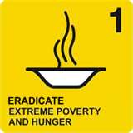


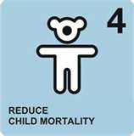

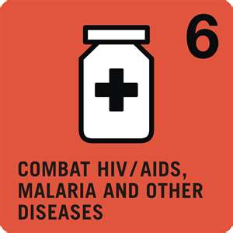


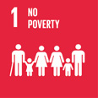
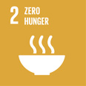
















Achievement of MDGs and Adaptation of SDGs: Context Bangladesh
Dr. Arafatur Rahman
Deputy Program Manager, DGHS
Ph: 01717862078

Slide 2
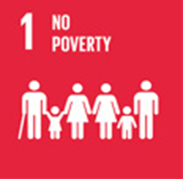

















Slide 3
SDG # 3: Targets (13 including 4 MoI)
Target 3.1: By 2030, reduce the global MMR to less than 70 per 100,000 live births
Target 3.9: By 2030, substantially reduce the number of deaths and illnesses from hazardous chemicals and air, water and soil pollution and contamination
Target 3.2: By 2030, end preventable deaths of new-borns and children under 5 years of age, with all countries aiming to reduce NMR to at least as low as 12 per 1,000 LB and U5MR to at least as low as 25 per 1,000 LB
Target 3.a: Strengthen the implementation of the WHO FCTC in all countries, as appropriate
Target 3.3: By 2030, end the epidemics of AIDS, tuberculosis, malaria and neglected tropical diseases and combat hepatitis, water-borne diseases and other communicable diseases
Target 3.b: Support the R&D of vaccines and medicines for the communicable and NCD that primarily affect developing countries, provide access to affordable essential medicines and vaccines, in accordance with the Doha Declaration on the TRIPS Agreement and PH, which affirms the right of developing countries to use to the full the provisions in the Agreement on Trade Related Aspects of IPRs regarding flexibilities to protect PH, and, in particular, provide access to medicines for all
Target 3.4: By 2030, reduce by one third premature mortality from NCD through prevention and treatment and promote mental health and well-being
Target 3.5: Strengthen the prevention and treatment of substance abuse, including narcotic drug abuse and harmful use of alcohol
Target 3.6: By 2020, halve the number of global deaths and injuries from road traffic accidents
Target 3.c: Substantially increase health financing and the recruitment, development, training and retention of the health workforce in developing countries, especially in least developed countries and small island developing States
Target 3.7: By 2030, ensure universal access to SRH-care services, including for FP, information and education, and the integration of RH into national strategies and programmes
Target 3.d: Strengthen the capacity of all countries, in particular developing countries, for early warning, risk reduction and management of national and global health risks
Target 3.8: Achieve UHC, including financial risk protection, access to quality essential health-care services and access to safe, effective, quality and affordable essential medicines and vaccines for all

Slide 4
SDG # 3: Data Availability (27 indicators)
Data Readily Available (12)
Data Partially Available (10)
Data Not Available (5)
Tier III (4)
3.4.1: Mortality rate attributed to cardiovascular disease, cancer, diabetes or chronic respiratory disease
3.5.2: Harmful use of alcohol
3.5.1
3.8.1
3.8.2
3.b.1
3.b.3
3.1.1: MMR
3.1.2: Births AB SHP
3.9.1: Mortality rate attributed to household and ambient air pollution
3.2.1: U5 mortality rate
3.4.2: Suicide mortality rate
3.2.2: Neonatal mortality rate
3.5.1: Treatment interventions for substance use disorders
3.9.2: Mortality rate attributed to unsafe water, unsafe sanitation and lack of hygiene
3.3.1: New HIV infections
3.6.1: Death rate due to road traffic injuries
3.3.2: Tuberculosis incidence
3.9.3: Mortality rate attributed to unintentional poisoning
3.3.3: Malaria incidence
3.8.1: Coverage of EHS
3.3.4: Hepatitis B incidence
3.8.2: people covered by health insurance/ a public health system
3.b.3 Proportion of health facilities that have core set of essential medicine
3.3.5: Neglected tropical diseases
3.7.1: Need for FP satisfied
3.a.1: Prevalence of current tobacco use
3.7.2: Adolescent birth rate
3.b.1: population covered by all vaccines
3.b.2: Total net ODA to medical research and basic health sectors
3.c.1: Health worker density and distribution
3.d.1: IHR capacity and health emergency preparedness

Slide 5

Draft Monitoring and Evaluation (M&E) of Sustainable Development Goal-3

Slide 6
2.2.1 Prevalence of stunting among children under 5 years of age

Slide 8
3.1.1: Maternal mortality ratio (per 100,000 LB)

Slide 9
3.1.2:Proportion of births attended by skilled health personnel

Slide 10
3.2.2: Neonatal mortality rate (per 1000 LB)

Slide 11
3.3.1: Number of new HIV infections per 1,000 uninfected population, by sex

Slide 12
3.3.2: Tuberculosis incidence per 100,000 population

Slide 13
3.3.3: Malaria incidence per 1,000 population

Slide 14
3.3.4: Hepatitis B incidence per 100,000 population

Slide 15
3.3.5: Number of people requiring interventions against neglected tropical diseases

Slide 16
3.4.1: Mortality rate attributed to cardiovascular disease, cancer, diabetes or chronic respiratory disease

Slide 17
3.4.2: Suicide mortality rate (per 100,000 population)

Slide 18
3.5.2: Harmful use of alcohol, defined according to the national context as alcohol per capita consumption (aged 15 years and older) within a calendar year in litres of pure alcohol

Slide 19
3.6.1: Death rate due to road traffic injuries

Slide 20
3.7.1: Proportion of women of reproductive age (aged 15-49 years) who have their need for family planning satisfied with modern methods

Slide 21
3.7.2: Adolescent birth rate (aged 10-14 years; aged 15-19 years) per 1,000 women in that age group

Slide 22
3.8.1 Coverage of essential health services (defined as the average coverage of essential services based on tracer interventions that include reproductive, maternal, new-born and child health, infectious diseases, non-communicable diseases and service capacity and access, among the general and the most disadvantaged population)

Slide 23
3.8.2: Number of people covered by health insurance or a public health system per 1,000 population

Slide 24
3.9.1: Mortality rate attributed to household and ambient air pollution (per 100000 population)

Slide 25
3.9.2: Mortality rate attributed to unsafe water, unsafe sanitation and lack of hygiene (per 100,000 population)

Slide 26
3.9.3: Mortality rate attributed to unintentional poisoning (per 100,000 population)

Slide 27
3.a.1: Age-standardized prevalence of current tobacco use among persons aged 15 years and older

Slide 28
3.b.1: Proportion of the population with access to affordable medicines and vaccines on a sustainable basis

Slide 29
3.b.2: Total net official development assistance to medical research and basic health sectors

Slide 30
3.c.1: Health worker density and distribution (per 10,000 population)

Slide 31
3.d.1: International Health Regulations (IHR) capacity and health emergency preparedness

Slide 32
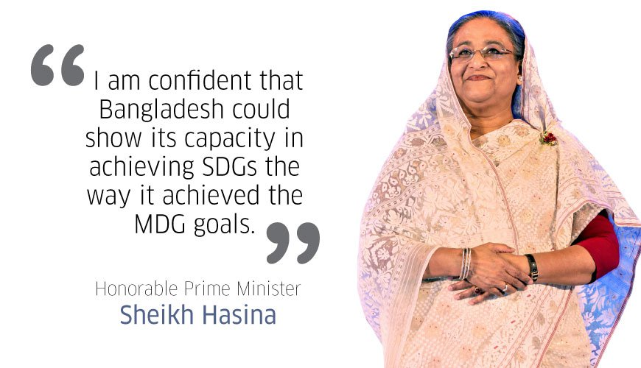
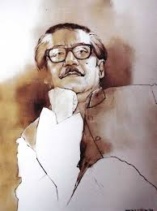
"Let us together create a world that can eradicate poverty, hunger, war and human sufferings and achieve global peace and security for the well being of humanity."
Bangabandhu Sheikh Mujibur Rahman,
Founding Father of Bangladesh

Slide 33

The woods are lovely, dark and deep, But I have promises to keep, And miles to go before I sleep, And miles to go before I sleep.
THANK YOU ALL

